Slide 1
NETWORK DESIGN FOR A COLLEGE
Team: Ra2011003010354 – vedant Tiwari
ra2011003010356 – gooty shaik mohammed Faheem
ra2011003010358 – pritom roy
ra2011003010365 – manojeet mahato

Slide 2
Problem Definition:
A simulation tool offers a way to predict the impact on the network of a hardware upgrade, a change in topology, an increase in traffic load or the use of a new application. So, we have designed a LAN of a college using Cisco Packet Tracer. The study provides an insight into various concepts such as topology design, IP address configuration and how to send information in form of packets in a single network and the use of Virtual Local Area Networks (VLANs) to separate the traffic generated by different departments.

Slide 3
Objective:
The Objectives of the “Network Design For a College” are:
To study topology
To design topology of the college
To study IP Addressing, Subnetting
To connect Switches and PCs using the Copper Cross-Over (Similar devices)/Copper Straight-through (Dissimilar devices) Cables
To configure the IP Addresses of the PCs
To simulate how to send information between the connected users (devices) and the use of VLANs to separate the traffic generated by different users or pathways

Slide 4
Local Area Network is the most basic computer network that connects devices within a building or group of buildings that are separated by a small distance.
Our project involves setting up a LAN for a college, by setting separate domains such as Computer lab, Library and Science Lab Departments and connecting their devise through routers.
The components used are:
S.No | Device | Required Nos.
1 | PCs | 54
2 | ROUTERS | 3
3 | SWITCHES | 6
4 | COPPER STRAIGHT-THROUGH CABLES | 55
5 | SERIAL DCE CABLES | 3
6 | SERVER | 1

Slide 5
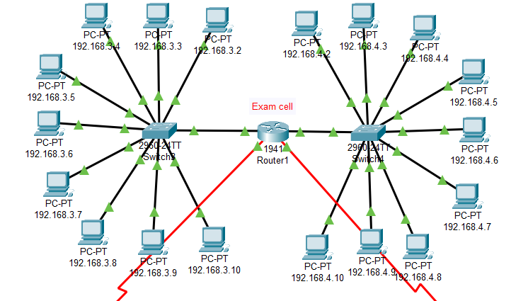
Network 1: Exam cell
9 PCs are connected on either side of two switches and are connected using Copper Cross- Over cables.
The switches are connected through a router.

Slide 6
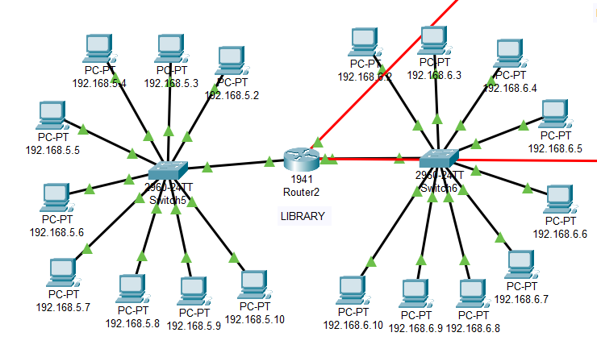
Network 2: Library Department
9 PCs are connected on either side of two switches and are connected using Copper Cross- Over cables.
The switches are connected through a router.

Slide 7
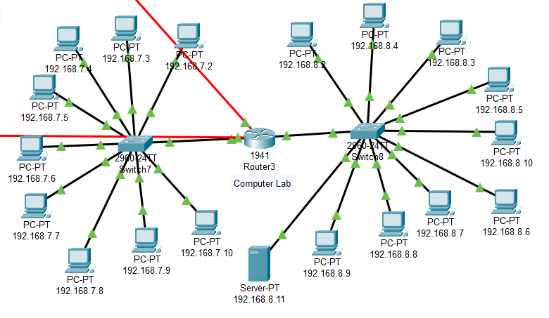
Network 3: Computer lab
9 PCs are connected on either side of two switches and are connected using Copper Cross- Over cables.
The switches are connected through a router.
Also, a server is connected to one of the switch.

Slide 8
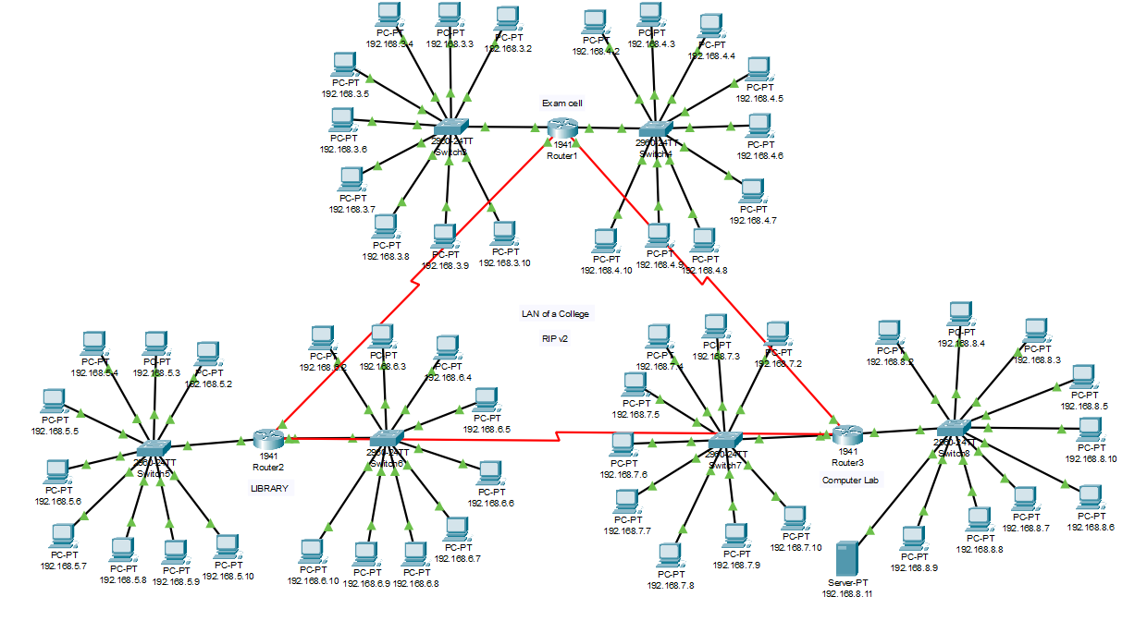
Network Design for College:

Slide 9
CONCLUSION:
Our project consists of a Local Area Network (LAN) that uses both the wired and wireless topology, using Cisco Packet Tracer. Every component, from the PC to router to switch to server, plays an important role in establishing proper connection. It is also noteworthy that the LAN can be further developed, and additional functionalities can be added to increase support and coverage. The procedures provide a veritable approach for the design of LANs for end-to-end IP network connectivity for next generation network (NGN) architecture implementations.

Slide 10
References:
https:// www.theijes.com/papers/vol6-issue10/Version-2/I0610026377.pdf
https:// www.slideshare.net/abhishekkumar5947/design-and-simulation-of-local-area-network-using-cisco-packet-tracer
https:// study-ccna.com/routing-protocols/
https:// www.geeksforgeeks.org/routing-information-protocol-rip/
https:// www.cisco.com/c/en_in/products/switches/what-is-a-lan-local-area-network.html

